Slide 1
IST664 – Natural Language Processing Twitter Emotion Recognition using RNN
Group 2:
Chaithanya Chikkannaswamy
Mars Sun
Nishitha Maniganahalli Venkatesh
Qinwei Huang

Slide 2
Goal and Motivation
Emotions are expressed in nuanced ways, which varies by collective or individual experiences, knowledge, and beliefs. Therefore, to understand emotion, as conveyed through text, a robust mechanism capable of capturing and modeling different linguistic nuances and phenomena is needed.
We aimed to predict emotion of various Tweets using Recurrent Neural Network approach.

Slide 3
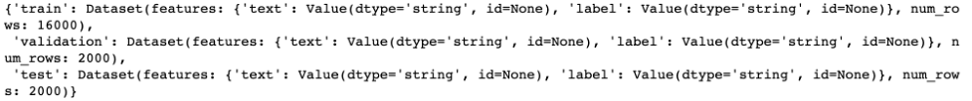
Data Description
We are using the default English Twitter messages dataset from the HuggingFace Hub 🤗with six basic emotions: anger, fear, joy, love, sadness, and surprise.
Inside the dataset, here are three separated datasets: train, validation, and test, which are ready for us to use. There are 20000 tweets in total, and 16000, 2000, 2000 records for train, validation and test respectively.

Slide 4
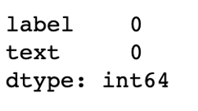
Missing Values
Let us take a closer look into the quality of data. First, we need to check if there are any missing values. After examinations on there datasets, it is obvious to see that there is no missing values within this dataset.

Slide 5
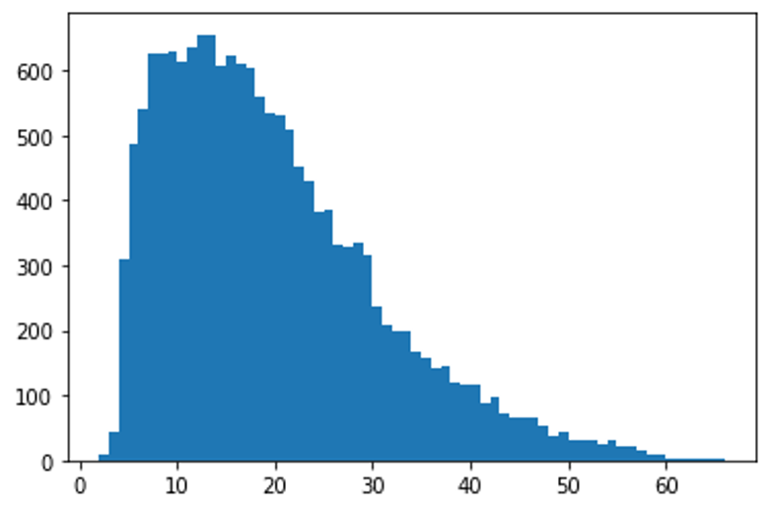
Exploratory Data Analysis
Lengths of tweets
Average: 19.1663125
Median: 17

Slide 6
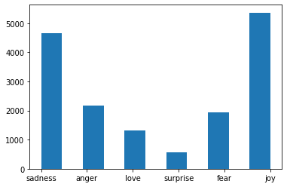
Exploratory Data Analysis
Count of different labels in the dataset

Slide 7
Data Preprocessing
Tokenizing
For RNN model, we first need to convert each unique word to unique number to feed model.
Texts to sequences
Example:
('i didnt feel humiliated’)
After converting:
[[2, 139, 3, 679]]

Slide 8
Data Preprocessing
Padding and Truncating Sequences
The input of model requires fixed shape. Therefore we need set max-lengths argument to a number. The words of tweets exceeds this number will be chopped off at the end. For words of tweets within this number will be padded with zeros.
Example:
Maxlens = 50
array([ 2, 139, 3, 679, 0, 0, 0, 0, 0, 0, 0, 0, 0,
0, 0, 0, 0, 0, 0, 0, 0, 0, 0, 0, 0, 0,
0, 0, 0, 0, 0, 0, 0, 0, 0, 0, 0, 0, 0,
0, 0, 0, 0, 0, 0, 0, 0, 0, 0, 0], dtype=int32)

Slide 9
Data Preprocessing
Preparing labels
{'fear': 0, 'joy': 1, 'surprise': 2, 'anger': 3, 'love': 4, 'sadness': 5}

Slide 10
Train-test Split
Dataset already split into training, validation, and test sets.
We plan to mix up the validation set and training set to create our own training and validation set to get multiple model accuracy and choose the average accuracy as the general accuracy of our model.
Training Set | Validation Set | Test Set
16000 | 2000 | 2000

Slide 11
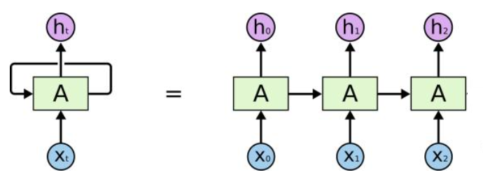

Models
RNN

Slide 12
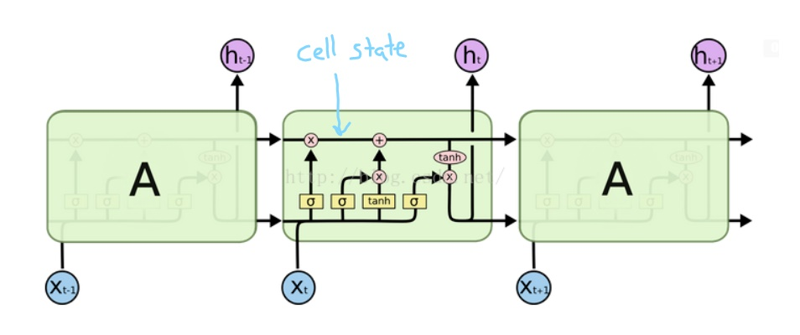
Models
LSTM

Slide 13
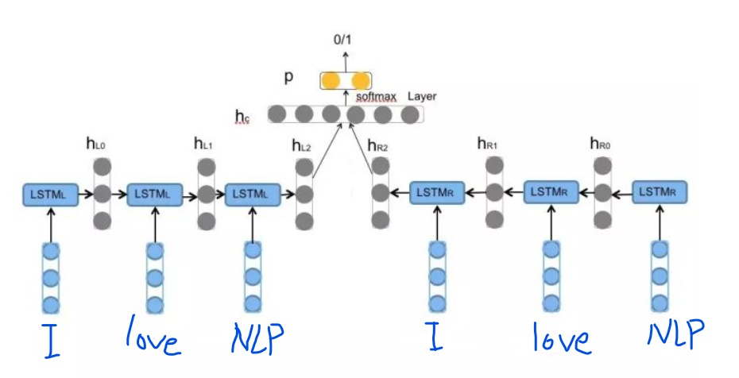
Models
BiLSTM

Slide 14
Models
BiLSTM
Embedding layer: input dimension: 10,000, output dimension: (16, 50)
First Bidirectional LSTM layer: 20 cells with return sequence set to True. (Returns a output in every timestamp or every cell)
Second Bidirectional LSTM layer: 20 cells
Output layer: 6 emotion classe, using activation function softmax.

Slide 15
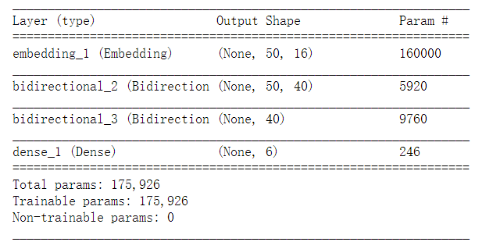
Models
BiLSTM

Slide 16
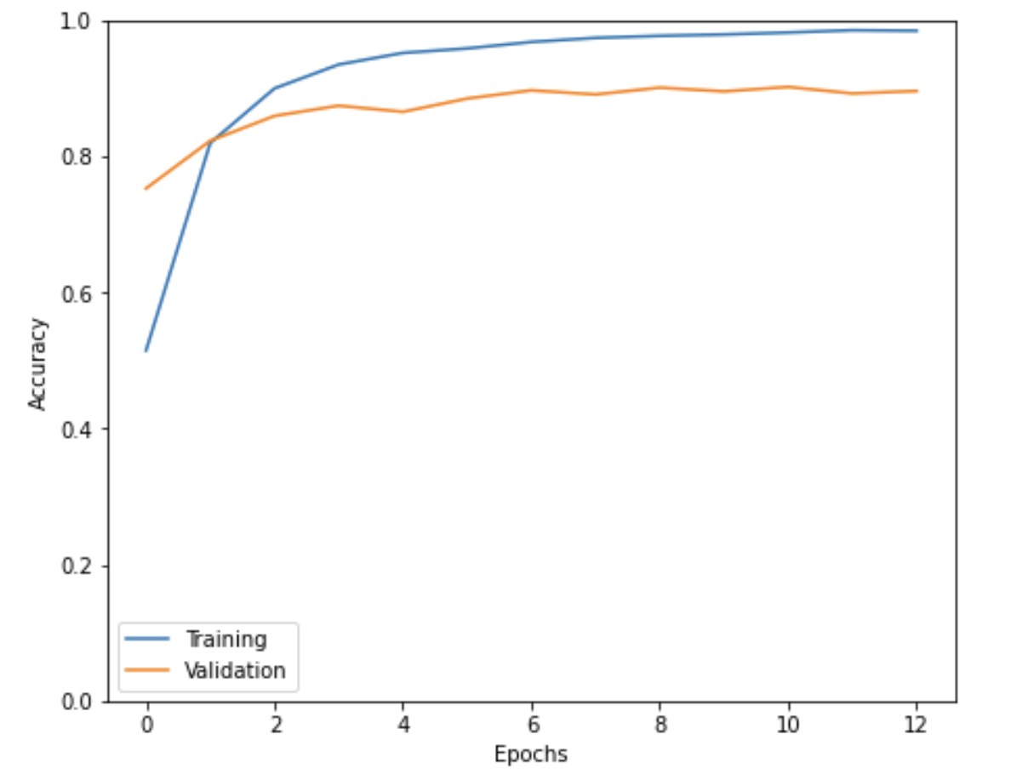
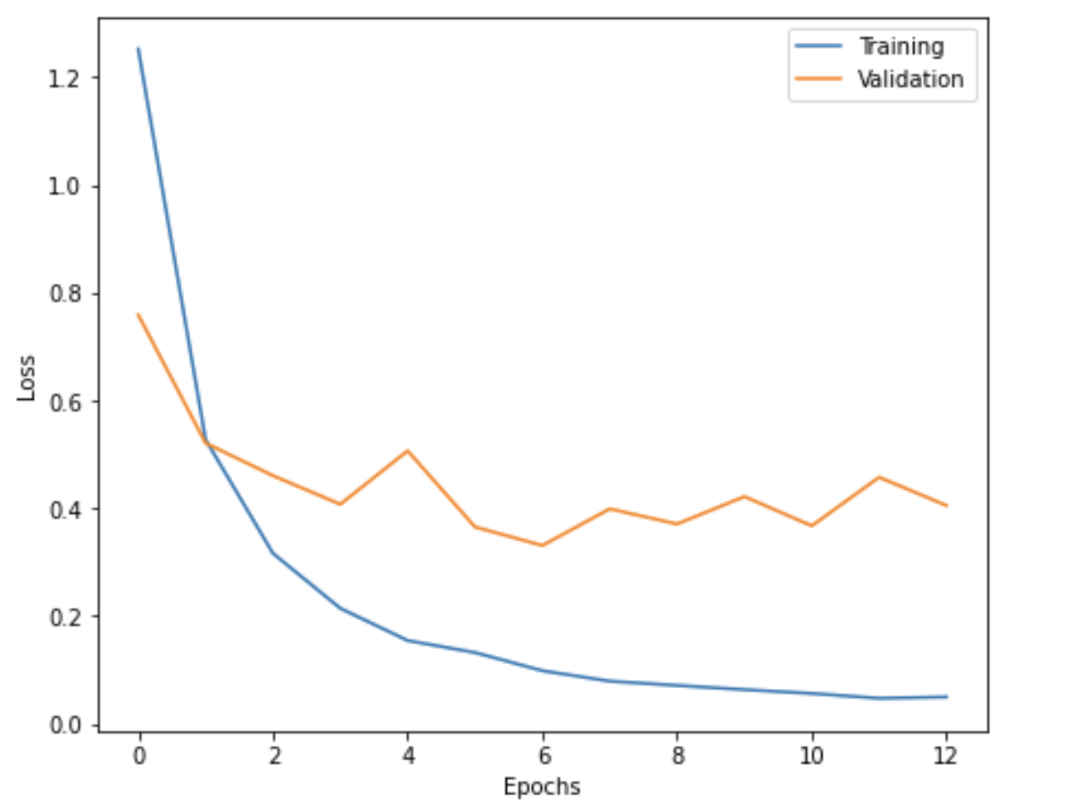
Model Evaluation
Visualization of training history:

Slide 17
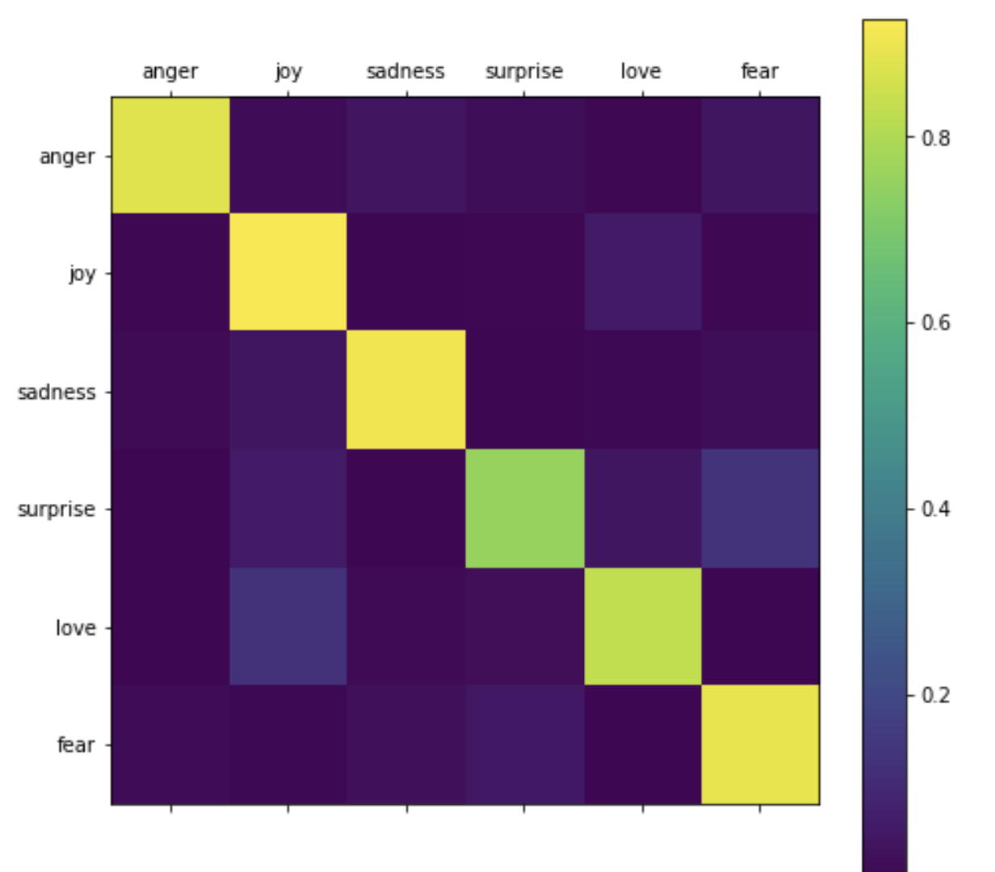
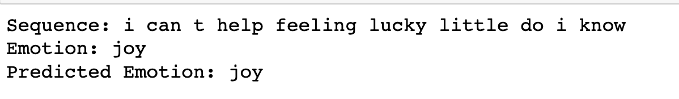
Results
Predicted emotions and the display of confusion matrix:
x axis: test labels
y axis: predicted emotions
Classes: set of labels

Slide 18
Future Work
To learn the performance difference between different NN model, we plan to implement a CNN to replace with the LSTM model. Then we will compare the performance of these two models.
Also, we plan to mix the given test, validation and train sets to create these sets by ourselves. We might change the percentage of these three sets to see the difference of model’s performance.

Slide 19
Conclusion
RNN model for the emotion recognition gave us the more accurate predictions and we were able to get high prediction accuracy.
BiLSTM-based approach to detecting the user’s emotion expression in tweets.
Model prediction accuracy:
Accuracy – 0.8985
Loss – 0.4029

Slide 20
References
[1] Elvis Saravia, Hsien- Chi Toby Liu, Yen-Hao Huang, Junlin Wu, Yi-Shin Chen, “Contextualized Affect Representations for Emotion Recognition”

Slide 21
Thank You!

